Slide 1
UBER’S MARKET DEMAND PREDICTION FOR NYC NEIGHBORHOODS

Slide 2
TEAM D
Anjali Goel
Sravani Bhagavathula
Sumalini Tyagi
Vaishnavi Krishnan

Slide 3
AGENDA
Business scenario recap
Data Collection
Exploratory Data Analysis
Machine Learning Models
Conclusion

Slide 4
BUSINESS SCENARIO RECAP
1

Slide 5
BUSINESS SCENARIO
Company must consider the market demand when planning their marketing strategies
With competition in the market, forecasting such demand becomes crucial, as even a slight imbalance can motivate a client to switch providers
Uber trips market demand analysis for NYC neighborhoods
Look at machine learning models, which can be used to predict the demand for user trips in NYC neighborhoods

Slide 6
DATA COLLECTION
2

Slide 7
DATASET USED
The datasets are collected from 3 different sources
2 dataset with different year’s NYC uber trips data
1 dataset with NYC neighborhood geospatial location data

Slide 8
EXPLORATORY DATA ANALYSIS
3

Slide 9
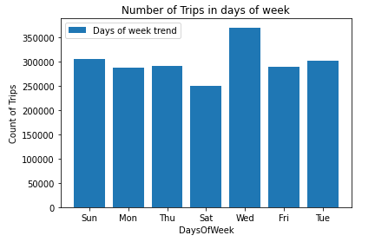
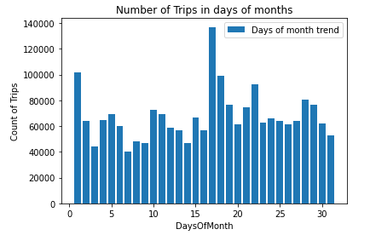
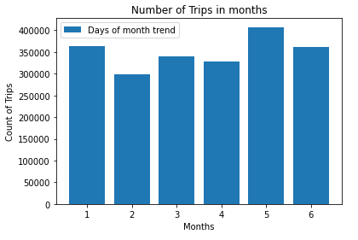
TREND ANALYSIS
Measured metrics for
- Number of Trips on weekdays
- Number of trips by days of month
- Number of trips per month

Slide 10
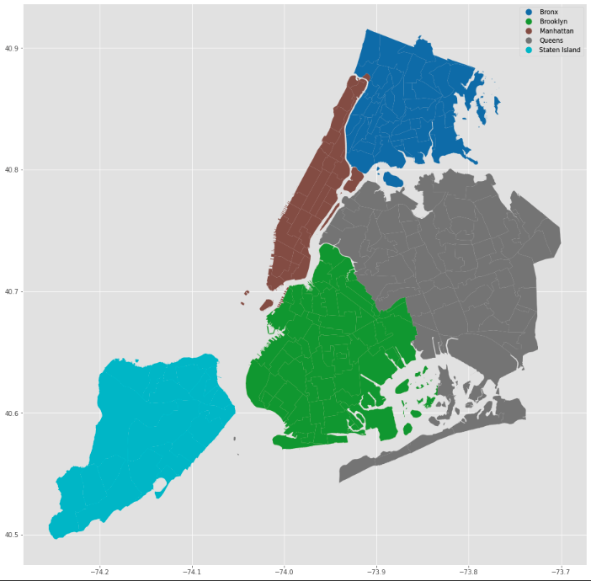
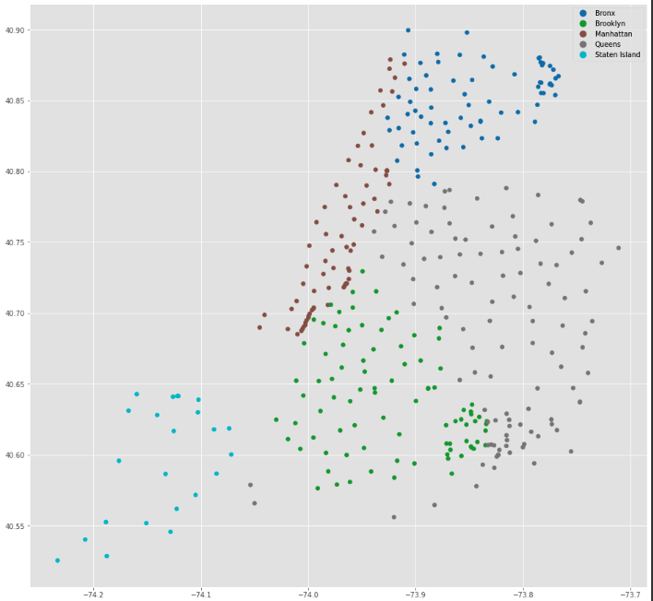
GEOSPATIAL DATA CONVERSION
- Retrieved data from Newyork City's 2010 Tabulation areas from the City of Newyork website.
- Converted the data from MultiPolygon to points (Centroid).
- Matched the points data from the Lattitude and Longitude information in the dataset.

Slide 11
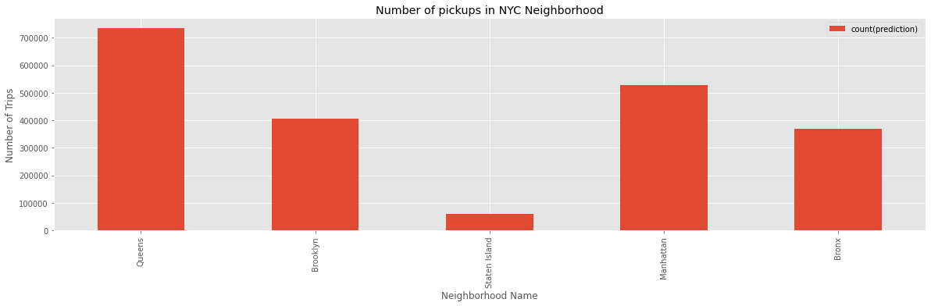
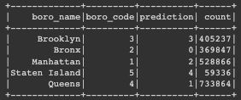
CLUSTERING USING K-MEANS
K – Means Clustering :
- Used the Latitude , Longitude to cluster the Uber pick-ups data into 5 clusters of the New York City neighborhoods.
- Crucial for identifying the areas with highest pickups

Slide 12
MACHINE LEARNING MODELS
4

Slide 13
USAGE IN PROJECT
Machine learning assisted us in building more robust estimates of RMSE (Root mean squared errors) as well as enabling us to make data-driven marketing decisions for increasing uber cars in hotspots
By identifying demand in a specific neighborhood, we would be able to direct partner drivers to areas where demand is high, thus increasing their earnings
Find the best model that helps to predict future demand. Here we are using 2016 data for Modelling

Slide 14
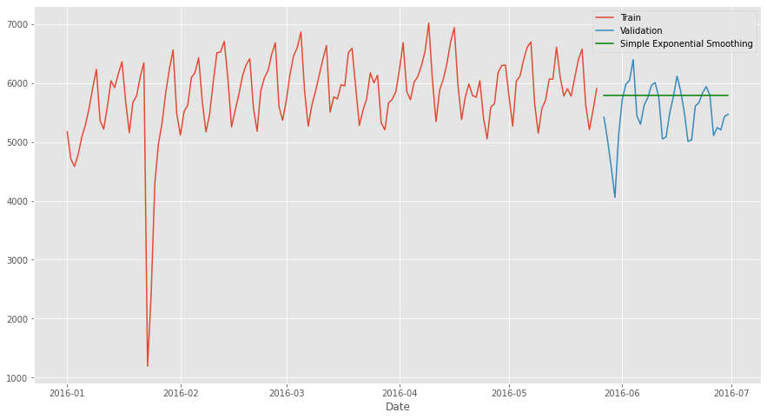
EXPONENTIAL SMOOTHNING
Divide the dataset into 80:20
Examining the forecast of smoothing plot to determine whether the model fits the data

Slide 15
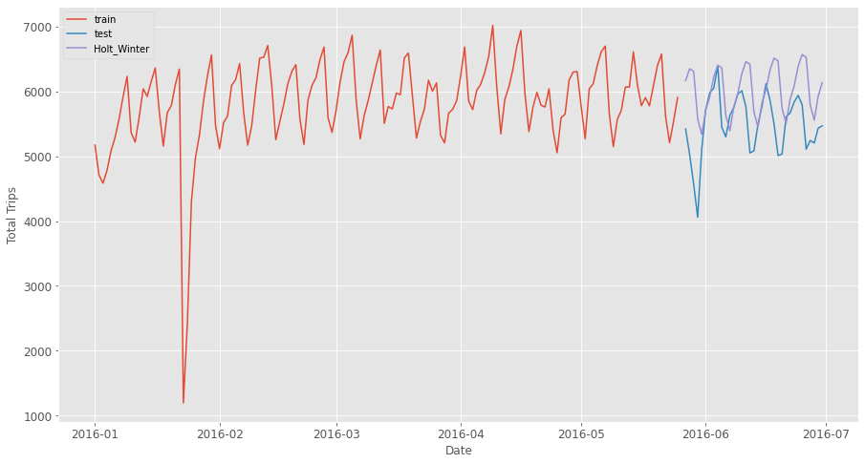
HOLT’S WINTER SEASONAL
Divide the dataset into 80:20
Examining the forecast of Holt's winter plot to determine whether the model fits the data

Slide 16
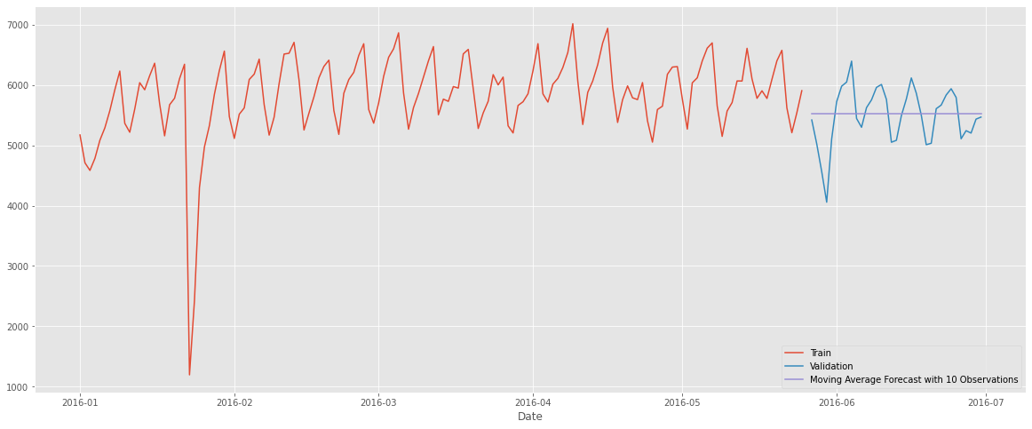
MOVING AVERAGE
Divide the dataset into 80:20​
Examining the forecast of Moving Average plot to determine whether the model fits the data

Slide 17
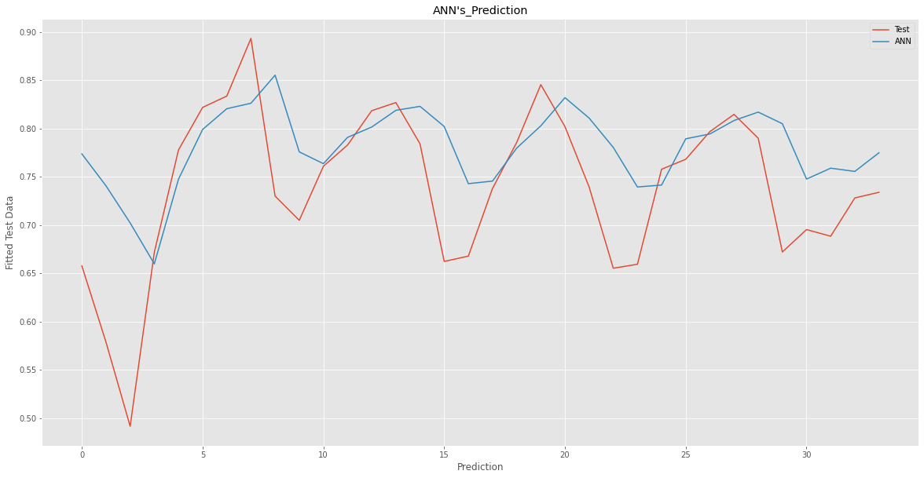
ARTIFICIAL NEURAL NETWORK
Inspired by an animal’s central nervous systems
Capable of machine learning as well as pattern recognition
The purpose of testing is to compare the outputs from the neural network against targets in an independent set (testing set)

Slide 18
CONCLUSION
 | RMSE
Exponential Smoothening | 546.36
Holt's Winter Seasonal Method | 645.62
Moving Average | 465.65
Artificial Neural Network | 0.076
ANN is more suitable for forecasting market demand prediction

Slide 19
LIMITATIONS AND FUTURE WORK
The size of the uber data that was limited to train our model
The uber data analysis concentrated on the pickup data and neighborhood
For future models we should factor in other parameters

Slide 20
THANK YOU!
Any questions?

